Slide 1


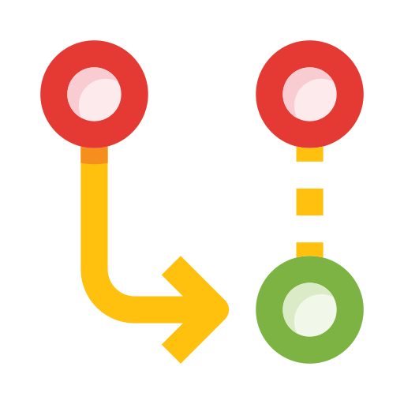








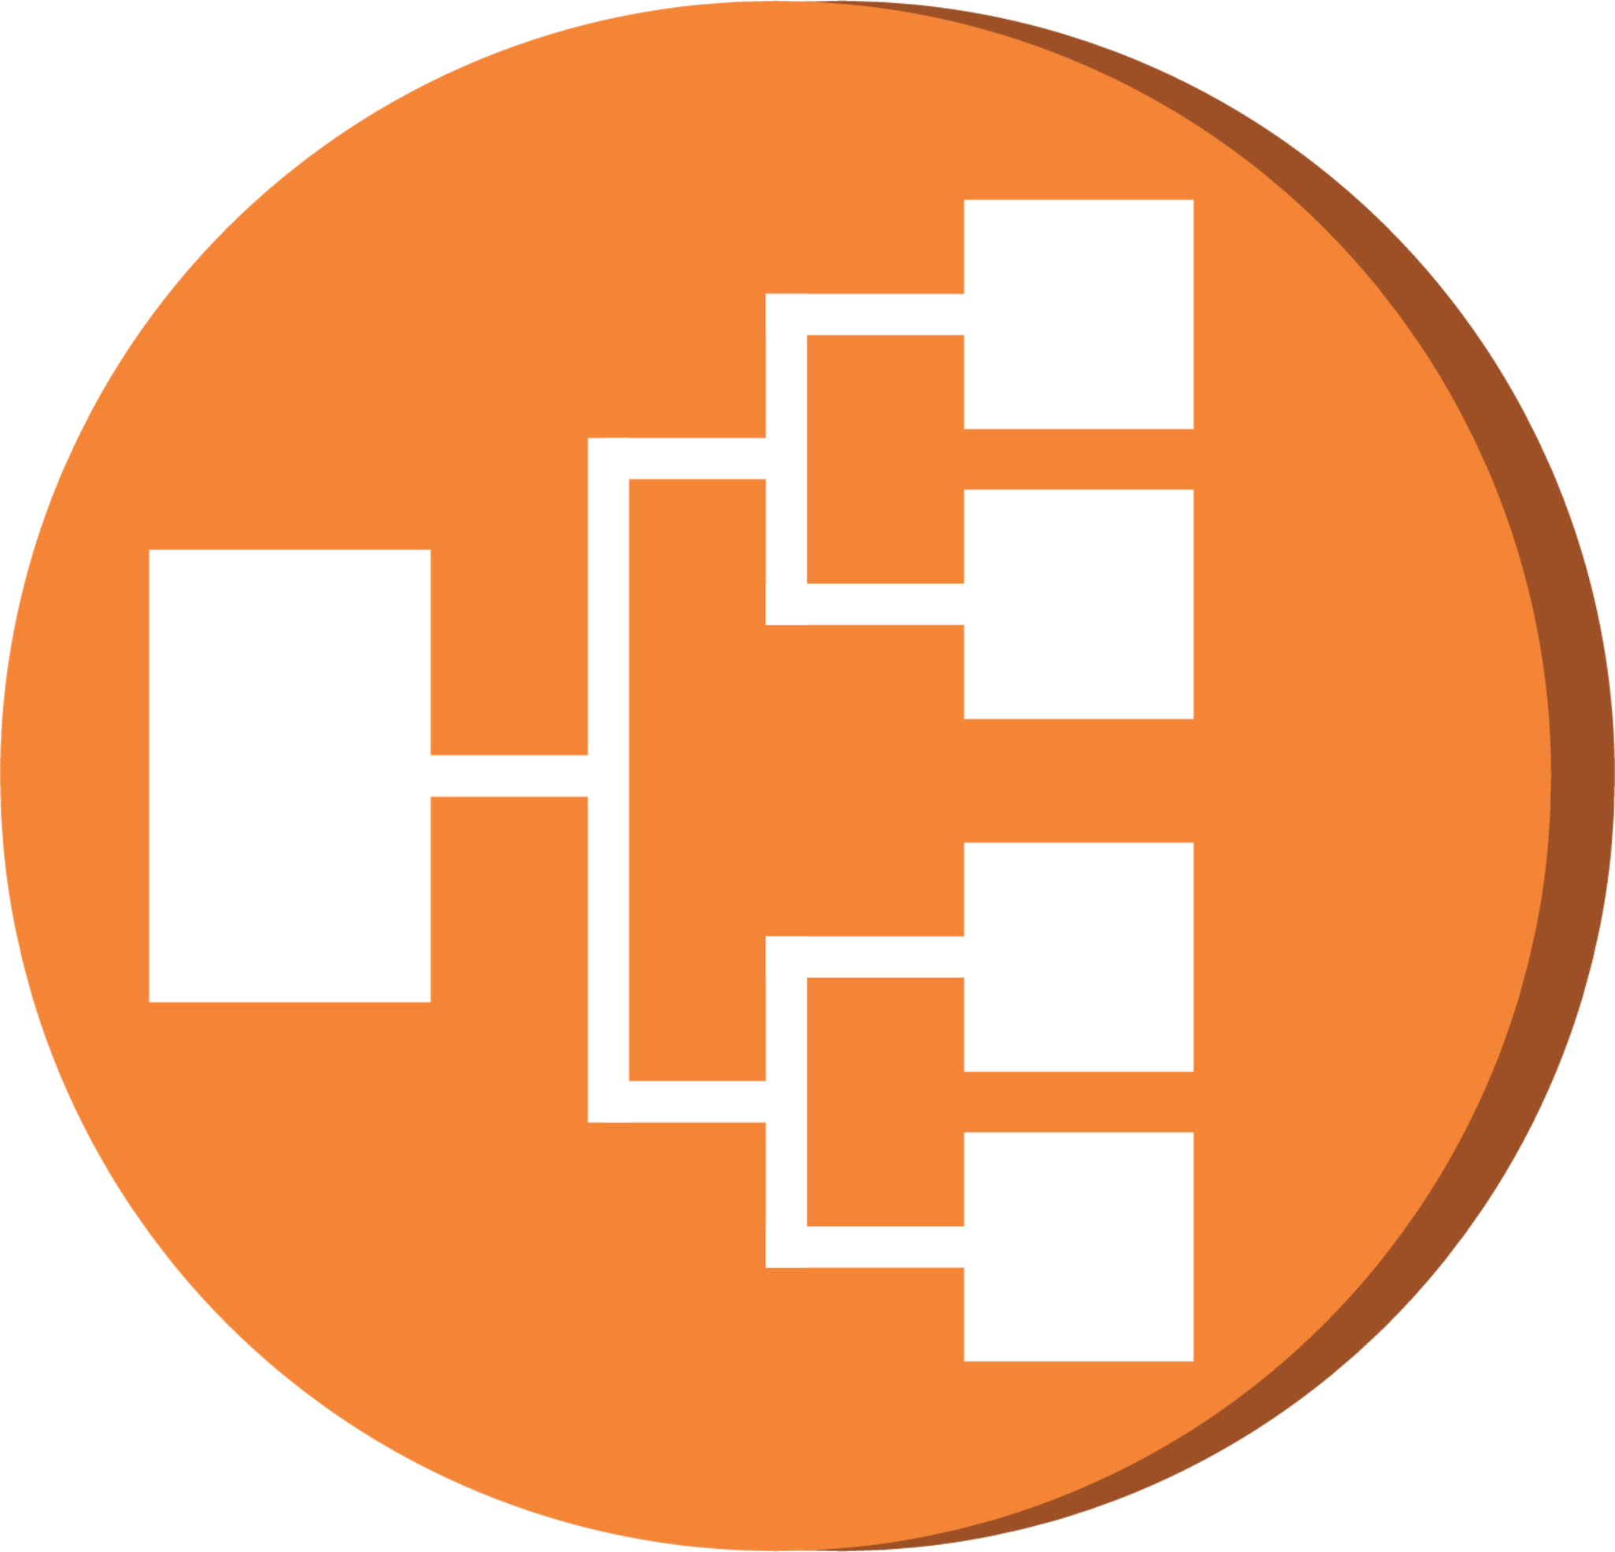









DEV
Get Last
Commit
PROD
Git Pull Request
Service.yaml
app:v1.0/healthcheck
Deployment.yaml
Bandit
Safety Check
Git Commit
Install Dependencies
Set ENV based
On branch
Security Scan and Vuln Test
Update Kubeconfig
Deploy K8s
Manifest
Developer
Lint Test
Build Image
Update K8s
Manifest
Deploy Service
ECR
Load Balancer
Push Image
To AWS ECR
Create ImagePullSecret
Get Pods
Unit Test
app:v1.0
By: Gabriel Okom
DEV
Terraform Workspaces
tf.state lock
tf.state
PROD
s3. Backend

